Slide 1





NEXT GEN EMPLOYABILITY PROGRAM
College Name: T john college
Team Name: Suma and team
https://nextgen.edunetworld.com
nextgenep@edunetfoundation.org

Slide 2
CAPSTONE PROJECT SHOWCASE
Project title: Trends of Email Marketing in India
Problem Statement| Project Overview| Solution & Proposed Value Proposition | Wow Factor | Modelling & Results | Team Intro | Q&A
Notes:
Let me quickly walk you through the brief plan for today. We are going to discuss the need for this program, what it offers to the students, how it will help you choose a fine career pathway, how to get enrolled in this program and so on….

Slide 3


V
Problem Statement
Email marketing is a form of direct marketing that uses email to promote products or services to a targeted audience. It can be an effective way to reach customers and build relationships with them. Some common strategies in email marketing include sending newsletters, promotional offers, and personalized messages.
Accurately measuring the ROI email campaigns requires proper tracking and attribution for the vast country like India it is a big and difficult challenge considering various norms and diversity like linguistic diversity cultural nuances and adhering to GDPR and PDBP regulations
Notes:
We now request our technical expert Mr so and so to help you understand the finer details of the course and curriculum.

Slide 4

Project Overview
By leveraging Power BI's data analysis and visualization capabilities, we can streamline the email marketing efforts in India. The platform enables us to gain valuable insights, track performance, and make data-driven decisions to enhance the effectiveness of your email marketing campaigns.
Power BI visualization: We can identify the key metrics and insights we want to derive from the email marketing data. For example, we can create visualizations to analyze email users , click-through rates, conversion rates, and subscriber demographics.
So, in short by using power BI visualization to gain insights into segment-specific Trend’s.

Slide 5
Solution:
Data Integration: Seamlessly integrate email marketing platforms with Power BI for centralized data.
Advanced Reporting and Visualization: Utilize interactive charts, graphs, and cards in Power BI to analyze email marketing performance .
Customized Dashboards and KPIs: Design personalized dashboards and define key performance indicators aligned with email marketing goals.
Data-driven Optimization: Uncover actionable insights from email marketing data to optimize content, timing, targeting, and overall strategy.
Proposed Value Proposition
Clean and transform data: Once your data is imported, clean and transform it as needed. This may involve removing duplicates and applying transformations to make the data suitable for analysis.
Design visualizations: Use Power BI's visualization tools to design engaging and informative dashboards and reports. Choose the appropriate visualizations to represent your email marketing metrics effectively. For example, you can create line charts to track open rates over time, bar charts to compare click-through rates by different segments.
Analyze performance: Utilize Power BI's analytical capabilities to gain insights into your email marketing performance in India. Explore your data to identify trends and patterns.

Slide 6
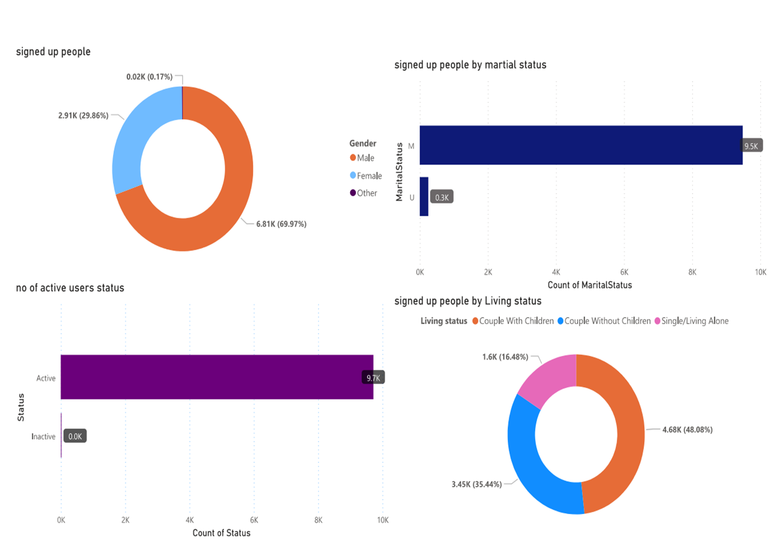
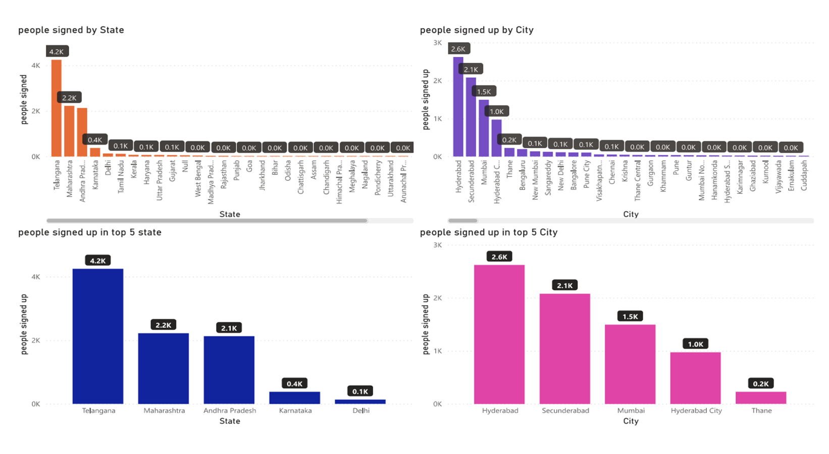
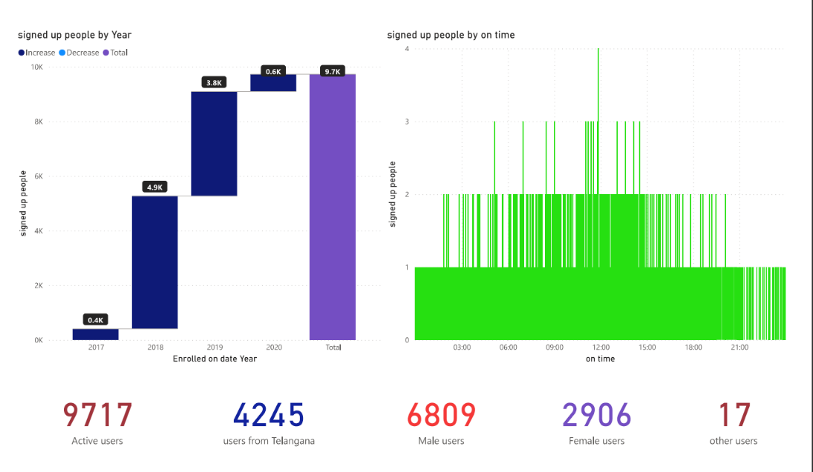
THE WOW in your solution
We have developed a model to classify users into two main categories :- Those who have enrolled in the email advertising campaign and those who have not. Furthermore, these categories are subdivided based on factors such as marital status, active users, financial status, gender, and geographical location.

Slide 7

Modelling & results

Slide 8

Modelling & results

Slide 9

Modelling & results

Slide 10





Meet our team
Team leader:- Suma
i.Likitha
iv.Suraj Agri
ii.Pranav
iii.Sathvik

Slide 11


Any
questions/comments?

